Slide 1
Analysis of Click Behavior and Click Prediction Model
Nianyi Wang | Analytic Data Warehouse

Slide 2
Nianyi Wang
Team:
Analytical Data Warehouse
School:
Colgate University
Hiring Manager:
Weichih Hung
Project:
Analysis of Click Behavior and Click Prediction Model

Slide 3
Motivations
Different Ads
Gain More Revenue!
Different Users
Notes:
We have different type of ads online or in apps and target on different type of users. But the main purpose is to gain more revenue.

Slide 4
Definitions
Multi-Click Creative
Creative that has two clicks or more per user.
Single-Click Creative
Creative that has exactly one click per user.
Notes:
First let’s look at how do we define different click behaviors.

Slide 5
Why do click behaviors matter?
Profit per 1000 impressions:
Multi-click creative: $2.65
Single-click creative: $2.00
Difference:
32.54%
Notes:
Then let’s talk about my motivation. Why do we care about the click behavior?
Since the difference between multi-click and single-click creative is really significant, we hope we can know how does a creative work ahead of time

Slide 6
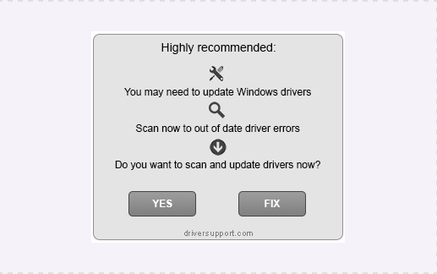
Multi-Click Example
Targeting information:
Age: 55+
Devices: Desktop
Operating System: Windows
11040
Users have multi-click on it
Notes:
This is an example of multi-click creative. This is a really special example because it doesn’t display the product on the ad directly. Instead, it looks like an error message in windows system and fools users to click on it and go to its website. From the result that more than eleven thousands users have multi-click on it, we can see that this creative design is really a success.

Slide 7
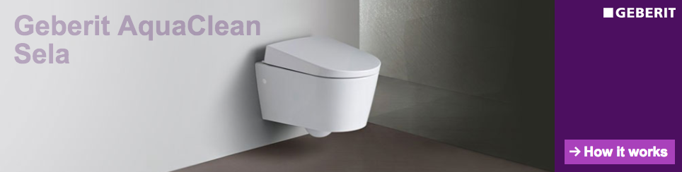
Single-Click Example
Targeting information:
Country: UK
Age: 35+
Notes:
This is an example of single-click creative. Its targeted country is UK because its landing page url is in uk. Its targeted age range is above 35. I think its main purpose is to attract users who are highly possible to buy this product. Users above 35 are more likely to have their own houses.

Slide 8
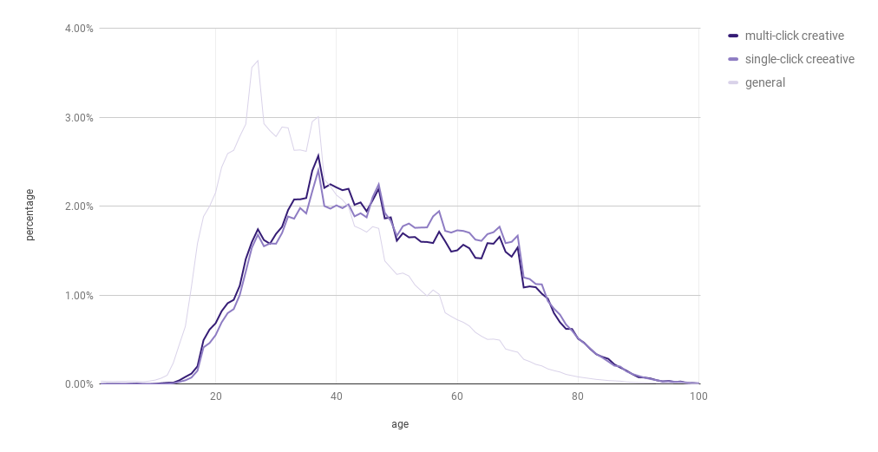
What will affect click behavior?
Age
Average age
Multi-click: 49.479
Single-click: 51.991
Notes:
After seeing some examples, let’s consider what will actually affect click behavior.

Slide 9
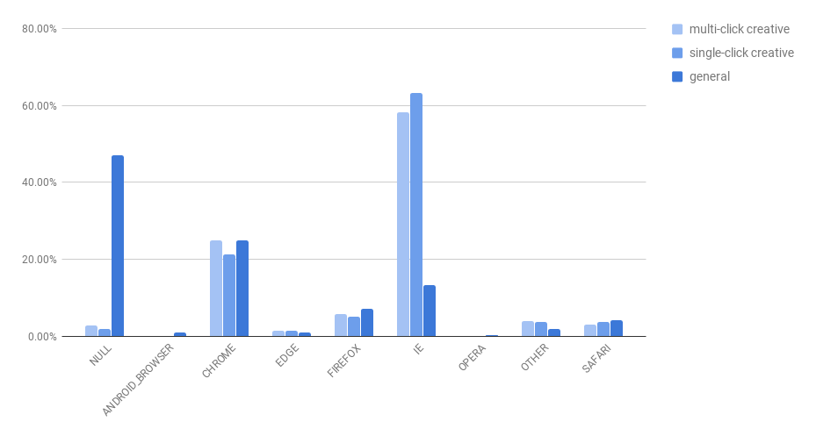
What will affect click behavior?
Browser
TTEST: 0.07315
Notes:
T-test: The t-test is used to find out if the means between two populations is significantly different.
F-test: F-test is used to find out if the variances between the two populations are significantly different.
The p-value is defined as the probability, under the null hypothesis , of obtaining a result equal to or more extreme than what was actually observed.

Slide 10
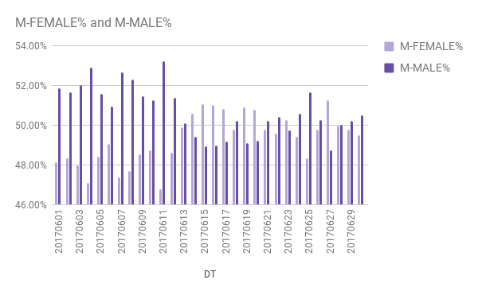
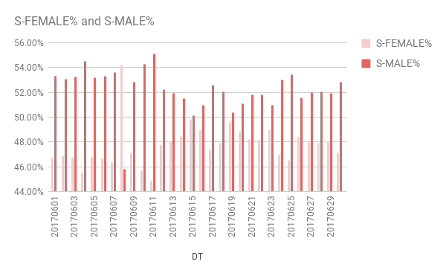
What will affect click behavior?
Gender
TTEST: 0.41121
TTEST: 0.40482

Slide 11
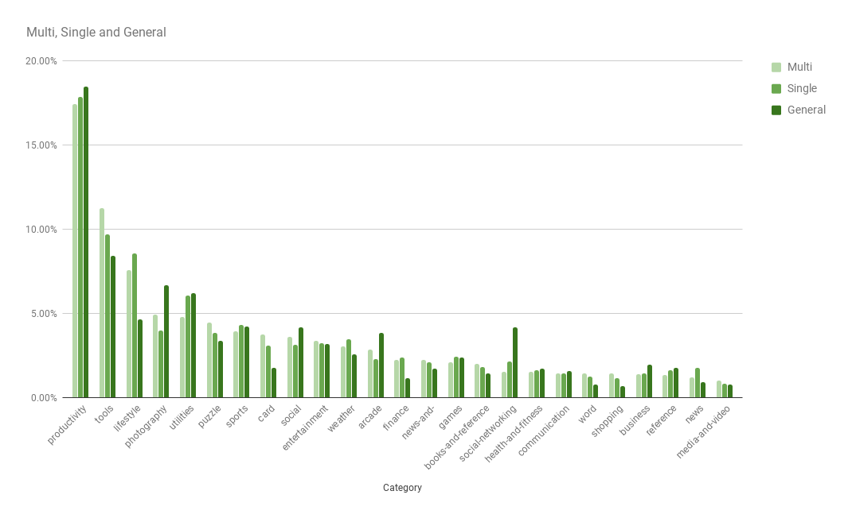
What will affect click behavior?
App Category
TTEST: 0.99354
Notes:
This is the graph for top 25 app categories. We can see that the tendency of both multi-click and single-click are almost same, and this result matches what we got from ttest.
In this case, even though there are some differences between different app categories, theyry won’t have large influence on users to click multiple times or just a single time.

Slide 12
Building Models
Tool: Vowpal Wabbit
Dataset:
Balanced
From DSP Event Table from 6/1 to 6/30 for 10GB
Hive
Pig
VW
Prediction
Get Data
Store Data
Train and Test
Notes:
Previously, we are looking at some features and trying to find out which are more important manually, and this can be quite subjective. Now we will use a more scientific method: machine learning.

Slide 13
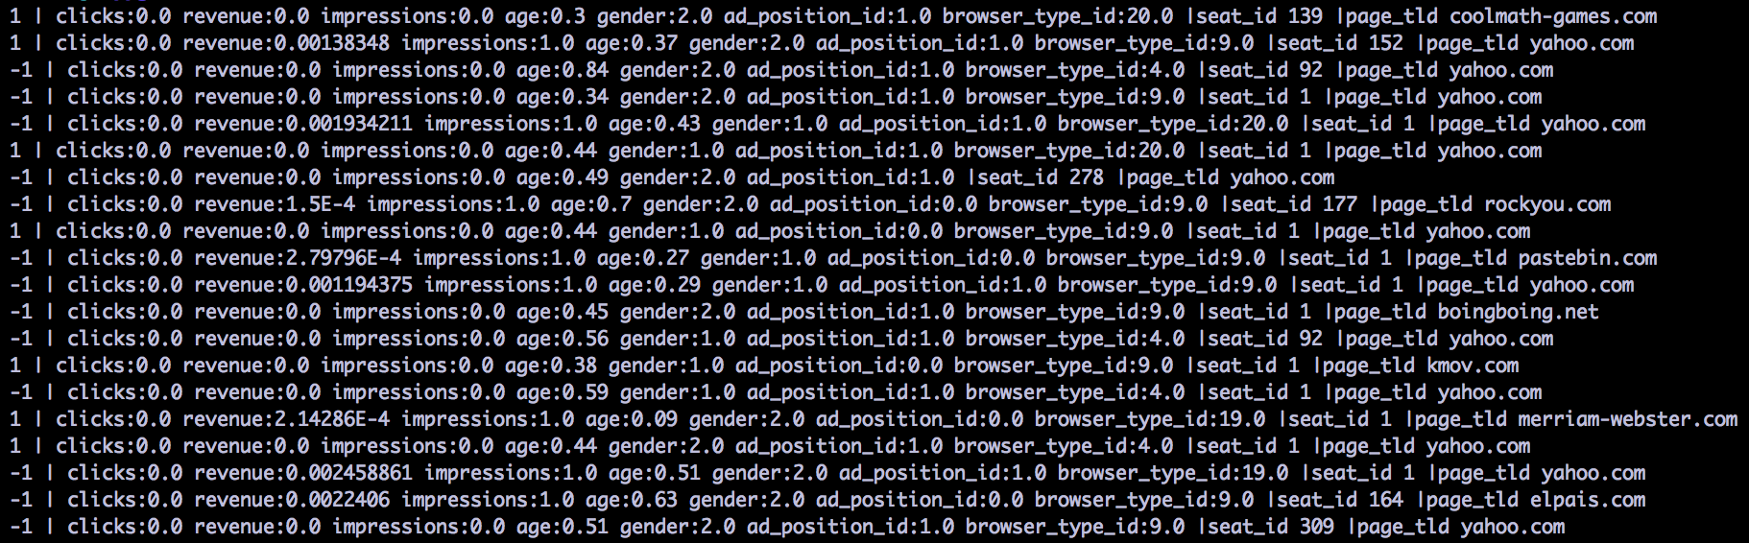
Building Models
Special input format for VW
Use pig udf to store data into required format
Notes:
To use vw, we need to have special input format. Since what we got from hive is table which has different style, we have to implement our own store function.

Slide 14
Models
Features:
age
gender
clicks
impressions
advertiser cost
ad position id
app name
page title
Parameter:
L1 regulation: 0.1
Accuracy: 65%
Features:
age
gender
clicks
impressions
advertiser cost
ad position id
app name
page title
seat id
browser type id
Parameter:
L1 regulation: 0.1
Accuracy: 76.3%
⬆17.4%
Notes:
We also tried with l1 value 1 and 10, but they have basically same accuracy.
If we try with l2 parameter, we get lower accuracy.
The accuracy of second model increased by 17.4%

Slide 15
Efficiency
Parallel learning
Spanning tree
Separate on 86 nodes
About 40 seconds to run one training process with 1 pass.
About 4-5 minutes to run one training process with 25 passes
More than thirty minutes to run one training process with 1 pass.
More than two hours to run one training process with 25 passes.
44 times faster
25 times faster

Slide 16


Important Results
ebay
Accuracy of prediction: 93.3%
Ratio of multi-click and single-click in the dataset: 1:1
Multi-Click
Single-Click
Notes:
Now there are some important results we got from the model.
First is ebay. The accuracy of prediction for creatives on website ebay.com can increase to 93.3%.
We also checked the ratio of multi-click and single-click in the dataset which is 1:1.
Because we want to exclude the some extreme cases such as the dataset contains only multi-click creatives.

Slide 17
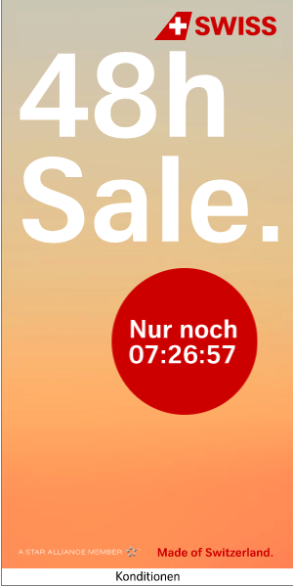
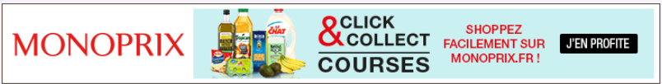
Important Results
.edu
Accuracy of prediction: 88.6%
Ratio of multi-click and single-click in the dataset: 3:1
Single-Click
Multi-Click
Notes:
Second is .edu. If the creatives are on websites with top level domain edu, the accuracy of prediction is 88.6% and the ratio is 3 to 1 so it’s still a good example.
Another interesting thing I find is that lots of creatives on .edu websites are in foreign language.
I think this is because most of the users on .edu websites are students all over the world. If they see something in their native language, it’s more likely for them to view or click on it.

Slide 18


Important Results
Kepler Group
Seat id: 152
Accuracy of prediction: 88.4%
Ratio of multi-click and single-click in the dataset: 8:1
Single-Click
Multi-Click
Notes:
Third on is seat id 152. This number stands for Kepler Group.
For creatives under Kepler Group, the accuracy of prediction is 88.4%.

Slide 19
Future Application
Put data into the model and get prediction.
Make further decisions or modifications according to the prediction.
After a new creative is put online or in apps for one day, we can gather all the information we need from adw.dsp_agg.
Predicted Multi-click creatives will be displayed more frequently in order to gain more revenue.

Slide 20
Git
VWMultiStorage
https://git.corp.yahoo.com/nianyiw/Intern-Project/blob/master/VWMultiStorage.java
Hive script
https://git.corp.yahoo.com/nianyiw/Intern-Project/blob/master/hive
Pig script
https://git.corp.yahoo.com/nianyiw/Intern-Project/blob/master/pig
Notes:
First let’s look at how do we define different click behaviors.

Slide 21
Thanks For Watching!

